Slide 1


BIRLA VISHVAKARMA MAHAVIDYALAYA (Engineering College) (An Autonomous Institution)
Guided by:
Dr. Nilesh prajapati
team:
Ayushya savani (18it430)
Harshil buha (19it401)
Sanket detroja (19it413)
Ayush sakariya (19it416)
Information Technology Department
4IT32 – Project II
1st Mid Semester Presentation

Slide 2

Coupon trader
Trade your unused coupon today

Slide 3
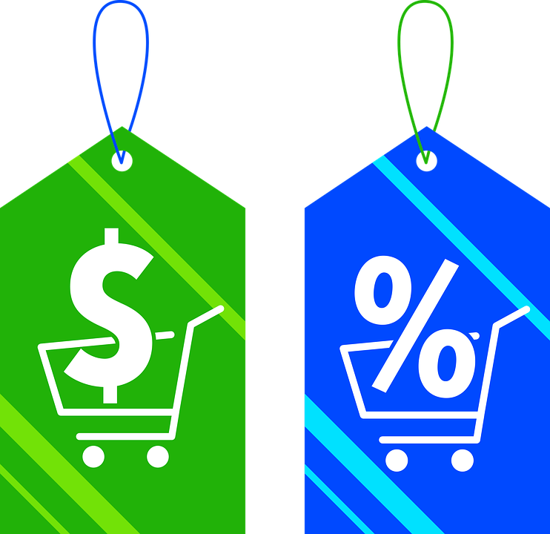
Outline of presentation
Objective
Scope
Introduction of the project
Project Requirements
Literature Survey
SRS
Timeline Chart
Modules (With Detailed Description)
Snapshots/Demonstration
Future Work
References

Slide 4

Objective
To create a platform for individuals to share and exchange vouchers and coupons from various online retailers and service providers.
The ultimate goal of the website is to provide a solution for individuals to save money on their online purchases by sharing and trading vouchers and coupons with one another.

Slide 5

scope
One of the most extensive scopes for this web application would be that it would be user-friendly and easy to operate like any other online business like Flipkart, Amazon, and so on as we are traders like them.
Develop a website for users to list and search for vouchers and coupons from various online retailers and service providers.
Allow users to create an account, list vouchers for sale, and search for coupons with the same single account per user.
Implement a secure payment system for users to buy or trade vouchers and coupons.
Provide a user dashboard for each user to manage their listings, orders, and account settings.
Only online applicable coupons are available on our platform.

Slide 6

Introduction of the project
Financial companies like Paytm, BharatPe, GooglePay, and so on, are providing coupons and rewards for every individual transaction.
Here, the problems come into the picture where most coupons are unused because they may not be necessary for that individual. So, to stop the coupon’s expiration, we are making a platform to trade coupons. This means people can buy and sell coupons before it gets expired.
Trading coupons that are not helpful for some people can be beneficial for another person. With the help of this system, unused coupons can be used by necessary people and both get the benefits of money.

Slide 7







Project requirements
Hardware:
No Specific hardware required
Software:
Front-end:
ReactJS
Mantine
Typescript
Back-end:
NodeJS
ExpressJS
MongoDB
JWT Token
Stripe
pnpm
This Photo by Unknown Author is licensed under CC BY-SA

Slide 8
Literature review
Application | Roll | Disadvantage
Rakuten | Rakuten is where you can get Cash Back for shopping at over 3,500 stores. Becoming a member is free! Stores pay Rakuten a commission for sending you their way, and Rakuten shares the commission with you as Cash Back. Get paid every three months, plus earn a cash bonus when you join and shop. | It works as affiliate marketing and works on purchasing power of use. It is connected with too many services so users cannot get clarity to maintain their motto. As compared to our service, we are giving a platform to buy and sell unused coupons, and due to that it would be projected to grow at a larger scale.

Slide 9
Application | Roll | Disadvantage
Ibotta | Ibotta offers real cash back on hundreds of everyday essentials at your favorite grocery retailers. No coupons, just cash. Choose from thousands of your favorite retailers and add offers to Your list by tapping the + in the app. For some retailers, you can even link your store loyalty account to Ibotta. | Despite o having a large scale, it just recently launched in India. Along with that, it only works on offline retailer stores as people are transforming their buying habits from offline to online. For that, we are providing coupons at a low cost so that every person who buys and sells coupons could be benefitted.

Slide 10
Application | Roll | Disadvantage
CouponDunia | CouponDunia is an affiliate marketing company - This means that when you shop via us on company partner stores, company get paid a "commission" by the store. They give more than 50% of this commission to you as cashback. | These types of websites are just promoting e-commerce websites to attract their product by selling price of high and at the same time giving discounts from these types of websites. Here, just e-commerce giants and affiliate marketers make money by creating hype about discount coupons.

Slide 11
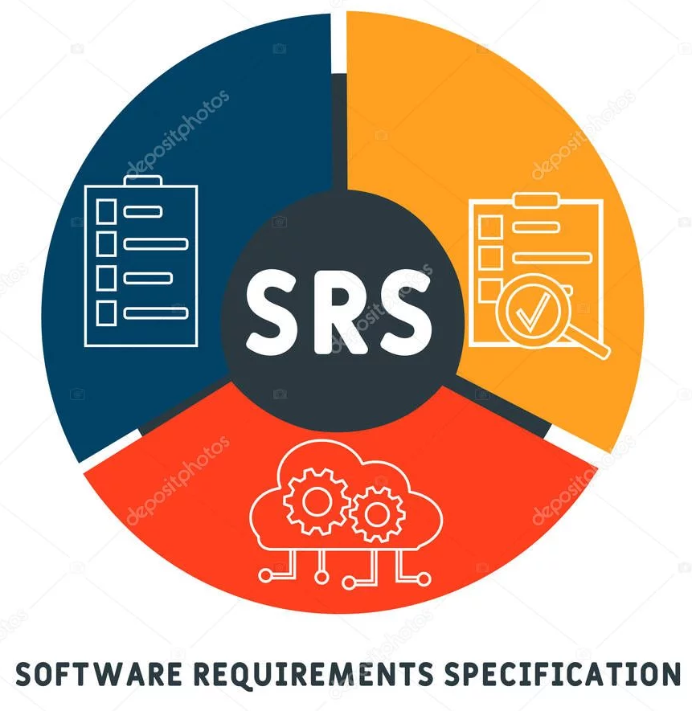
srs
Use case Diagram
Activity Diagram
Sequence Diagram
Entity Relation Diagram
Data Flow Diagram
Class Diagram
Timeline Chart

Slide 12
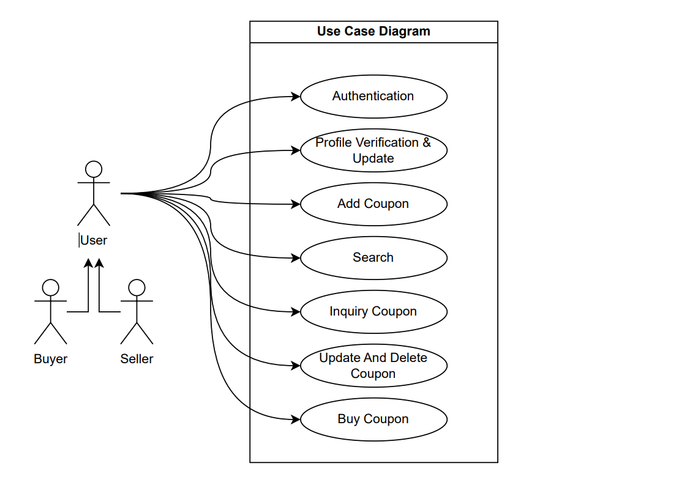
Use-case diagram

Slide 13
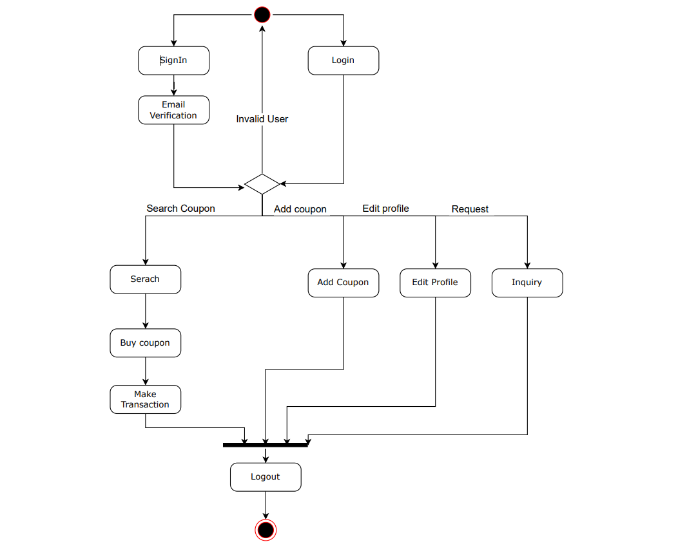
Activity Diagram

Slide 14
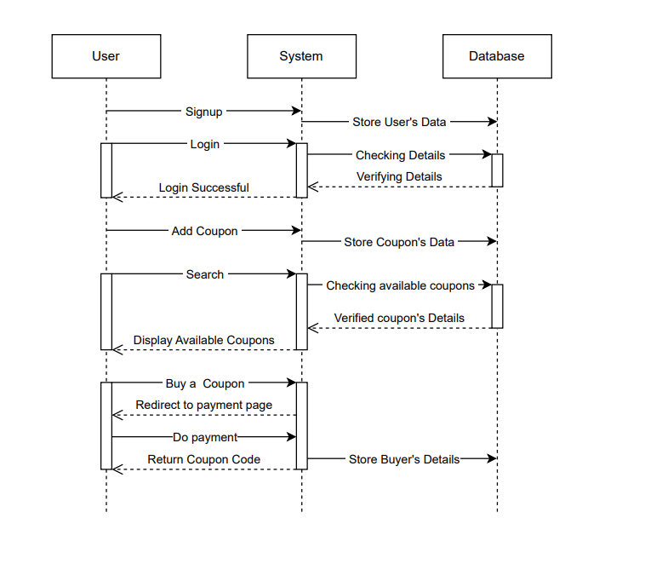
Sequence diagram

Slide 15
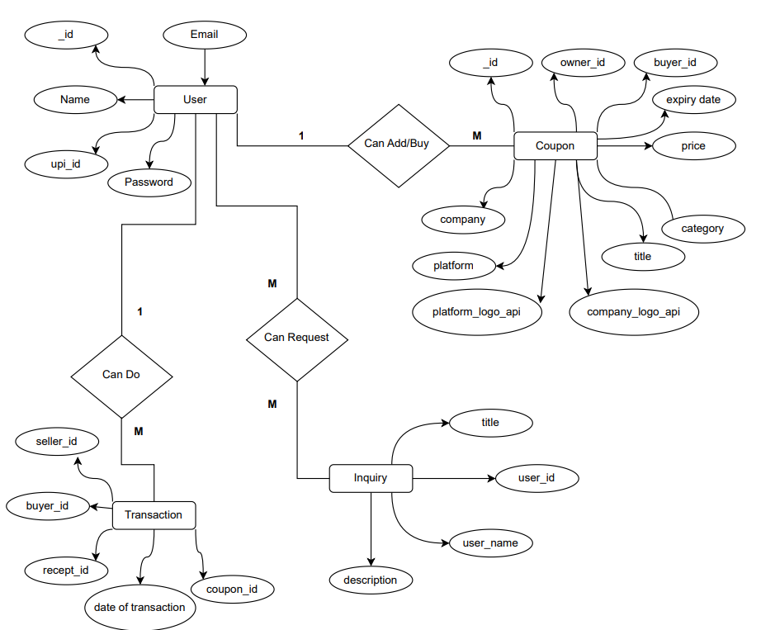
Entity Relation Diagram

Slide 16
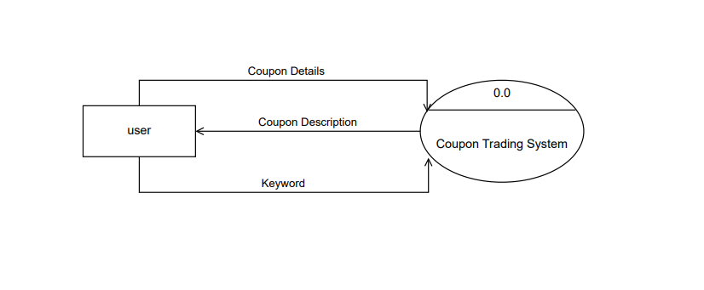
Data Flow Diagram Level 0

Slide 17
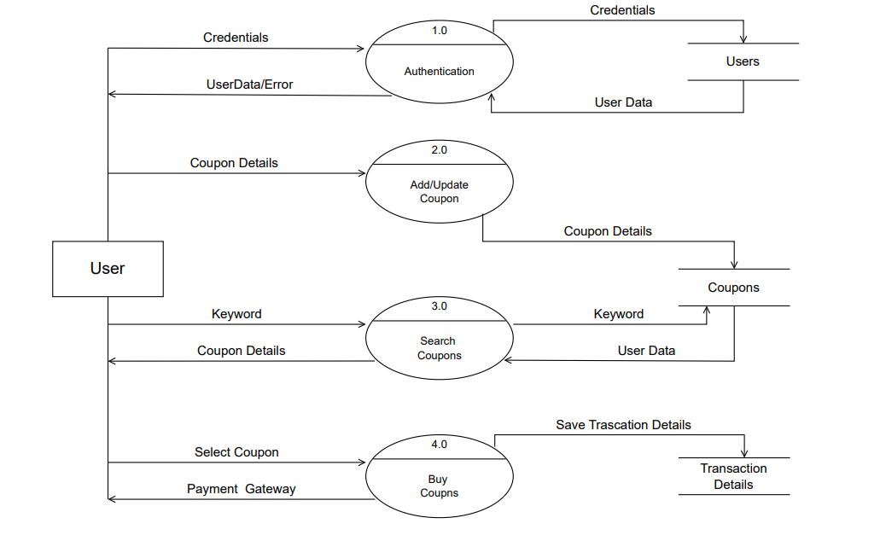
Data Flow Diagram Level 1

Slide 18
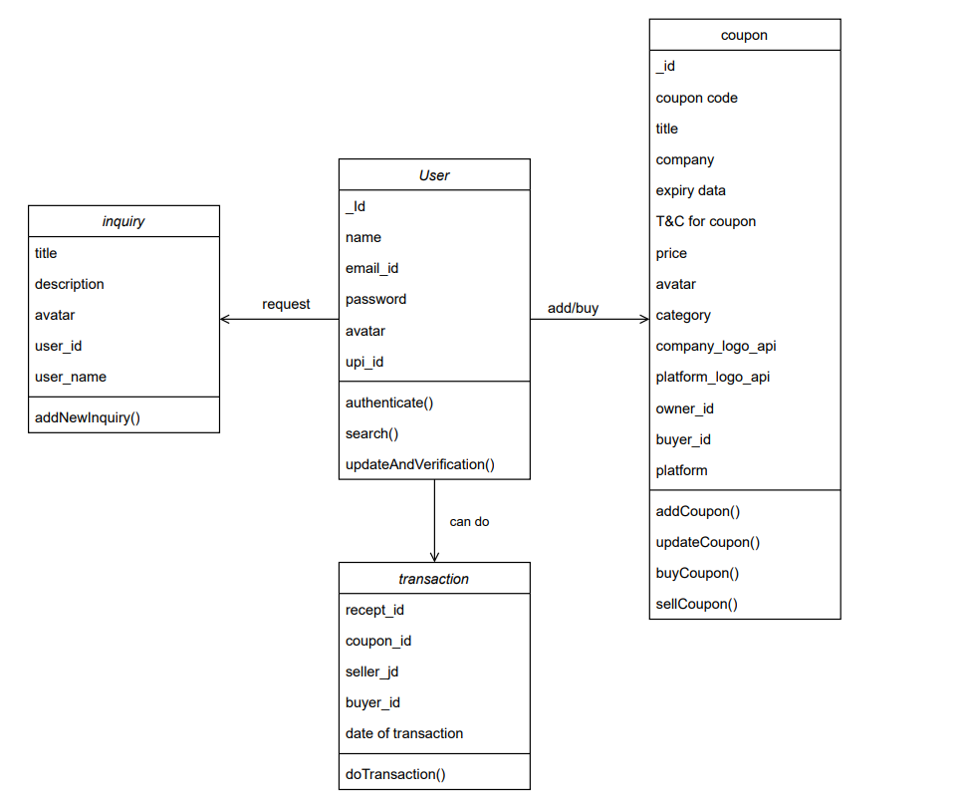
Class Diagram

Slide 19

Timeline chart

Slide 20

modules
Authentication
Profile Verification & Update
Add Coupon
Search
Inquiry Coupon
Update and Delete the Coupon
Transaction

Slide 21

authentication
This module provides sign-in and log-in facilities and authentication with JWT Tokens.
In sign-in users have to pass some personal details to the system to create a new user account into the system.
Using those credential user can log-in to the system later on, which is very easy.

Slide 22

Profile Verification & Update
Through this module, verification of the user will be done and the user can update profile details.
For profile verification, the system sends a link to the registered email address. The user has to tap on link to verify via email.
User can change their personal detail like name, email address.

Slide 23

Add Coupon
In this module user can add coupon.
With all this essential information user has to provide to system.

Slide 24

Filter
In this module, filter feature is available.
In search, the system provides different kinds of filters for easy search of coupon on the basis of category for the user.

Slide 25

Inquiry Coupon
Users can request new Coupons here.
If a user wants a Coupon for a particular purchase, which is not available in the system then the user can put a query request on the query page.
These query requests are publicly visible to all the users on the query page.

Slide 26

Update And Delete the Coupon
Here, the user can update their coupons and delete them.
So, it can be flexible for users to commit to our service platform.

Slide 27

Transaction
User can Directly purchase their Coupons and receive payments via Debit card or Credit card or virtual wallet. So, it will be straightforward for users for adopting the new platform environment.

Slide 28

Future work
We can also include a section for negotiation where users can negotiate on purchasing and selling vouchers and gift cards.
we can also add another section for globally circulated vouchers from other websites using APIs (because sometimes they may work or may not).
We would also develop an android app and launch it on the play store which will make our platform more dynamic and global.
Upgrade the user interface for more attraction and availability for users.
We can also implement a notification feature as people can get notified we sometimes upload a new voucher or gift card.

Slide 29

References
[1] https://www.rakuten.com/
[2] https://home.ibotta.com/
[3] https://www.coupondunia.in/

Slide 30


Thank you
Coupon Trader

